Slide 1
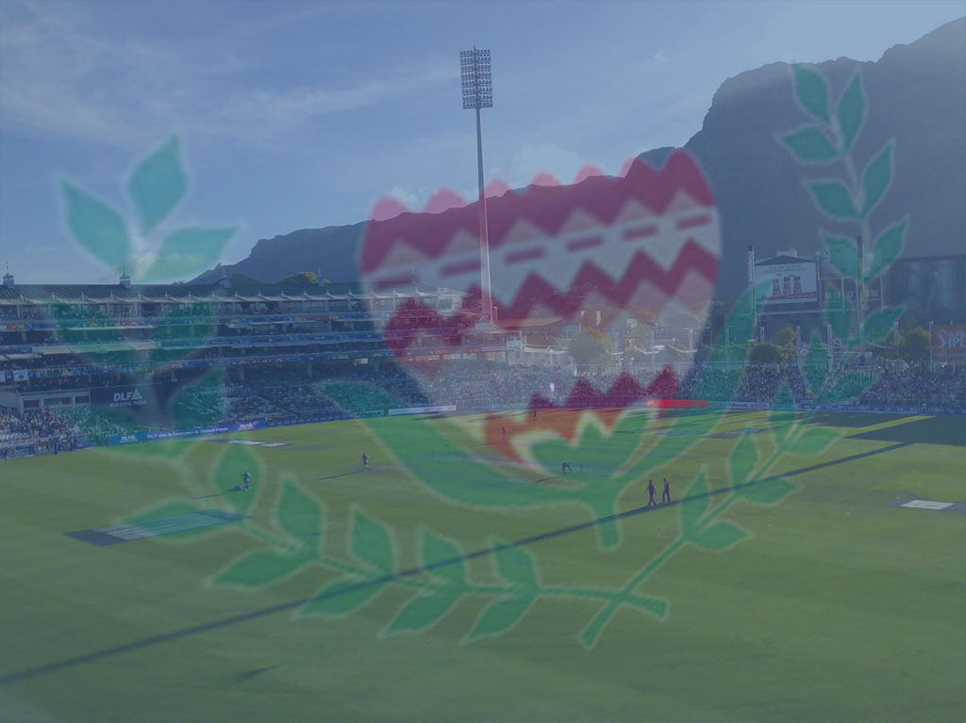
Western Province
Cricket Association
2017-18
Playing Conditions

Slide 2
ONE DAY COMPETITION
2 sessions of 3 hours and 30 minutes, separated by a 40-minute interval between innings.
Hours of Play:
First Session: 10:00 – 13:30
Interval: 13:30 – 14:10
Second Session: 14:10 – 17:40
Drinks every 1h 10 mins (70 mins)
10 run penalty for every over that starts after cut-off time!!! New for 50 over cricket this season

Slide 3
ONE DAY COMPETITION
50 overs each (min 20 overs)
Team batting 2nd to face number of overs completed in time.
Max 10 overs per bowler.
2 short deliveries per over.
No Runners
FREE HIT for ALL No-Balls.

Slide 4
ONE DAY COMPETITION
BONUS POINTS:
With Bonus Point: 5
Without Bonus Point: 4
Tie / NO Results: 2
Loss: 0
NO Super Overs

Slide 5
ONE DAY COMPETITION
Inner circle on the field – radius of 27.43 meters from both middle stumps.
Circles to be marked by a painted line or plastic/rubber discs.
Power Plays as follows…

Slide 6
ONE DAY COMPETITION
POWER PLAY 1: OVERS 1 – 10:
MAXIMUM 2 FIELDERS outside the inner circle.
POWER PLAY 2: OVERS 11 – 40:
MAXIMUM 4 FIELDERS shall be permitted outside this fielding restriction area.
POWER PLAY 3: OVERS 41 – 50:
MAXIMUM 5 FIELDERS shall be permitted outside this fielding restriction area.

Slide 7
Western Province
Cricket Association
2017-18
Playing Conditions

Slide 8
AMA 20/20
2 sessions of 1 hour and 25 minutes, separated by a 20-minute interval between innings.
Morning Games:
First Session: 10:00 – 11:25
Interval: 11:25 – 11:45
Second Session: 11:45 – 13:10
Afternoon Games:
First Session: 14:00 – 15:25
Interval: 15:25 – 15:45
Second Session: 15:45 – 17:10

Slide 9
AMA 20/20
20 overs per side. (min 5 overs)
1 hour 25 minutes (85 mins) to bowl 20 overs.
10 run penalty for every over that starts after cut-off time.

Slide 10
AMA 20/20
MAX 4 overs per bowler.
FREE HIT for ALL no-balls.
(Premier & First Div A – D)
No field changes on free hits for same striker.

Slide 11
AMA 20/20
Power Play: first 6 overs. MAX 2 fielders outside inner circle.
1 short delivery above shoulder height allowed per over.
High full toss above waist – 1st & final warning if directed at body.

Slide 12
AMA 20/20
BONUS POINTS:
With Bonus Point: 5
Without Bonus Point: 4
NO Results: 2
Loss: 0
Tied Match = Super Over

Slide 13
AMA 20/20
Substitutes allowed for fielder who suffers illness or injury.
If a fielder is off the field for any amount of time for internal injury, must make up penalty time before he can bat or bowl.
Penalty time carried into batting innings.
Serve penalty time (max 90 minutes) or 5 wickets down.

Slide 14
Western Province
Cricket Association
2017-18
New Laws

Slide 15
NEW OR CHANGED LAWS
Applicable to all Leagues & Competitions
A substitute can act as a wicketkeeper with umpires approval
Catches, Run-outs & stumpings off helmets now all possible
Bowling practice on the square during a match is now 5 penalty runs to the batting side after a 1st & final warning
A deliberate short run by any batsman is now immediately 5 penalty runs to the fielding side
Batsman’s feet cannot end up in the protected area of the pitch when playing a forward defensive
Penalty time off the field kicks in immediately - no more 8 minutes grace period. No penalty time for external blow.
Once a batsman makes his ground, he remains safe even if his bat or person becomes raised beyond the popping crease
Handled Ball is now incorporated under Obstructing the field

Slide 16
Western Province
Cricket Association
2017-18
PC’s & New Laws
Questions / Comments

Slide 17
AMA 20/20
BONUS POINTS CALCULATION:
In an uninterrupted Ama20 match, Team A is bowled out for 108 in 18 overs.
How many runs do they need to restrict Team B to, to win by a bonus point?
How many overs does Team B need to reach the target in, to win with a bonus point?

Slide 18
50 OVERS
BONUS POINTS CALCULATION:
In a 50 over match, Team A scores 212-8 in their allotted 50 overs.
During the interval, rain delays the start of Team B’s innings, which is reduced to 37 overs
What is Team B’s target to win the match in 37 overs?
How many overs does Team B need to reach the target in, to win with a bonus point?
How many runs does Team A need to restrict Team B to, to win by a bonus point?

Slide 19
AMA 20/20
REDUCED OVERS CALCULATION:
When 1 to 30min are lost, reduce interval to 15 minutes
When >30mins are lost, reduce interval to 10 minutes
Interval can’t be calculated to <10min

Slide 20
AMA 20/20
REDUCED OVERS CALCULATION:
An Ama20 morning match starts at 11h15 due to a damp pitch
Calculate how many overs per side the match will be reduced to

Slide 21
50 OVERS
REDUCED OVERS CALCULATION:
When 1 to 60min are lost, reduce interval to 30 minutes
When 61 to 120min are lost, reduce interval to 25 minutes
When >120mins are lost, reduce interval to 20 minutes
Interval can’t be calculated to <20min

Slide 22
50 OVERS
REDUCED OVERS CALCULATION:
Rain interrupts a 50 over match at 11h45 after 25 overs have been bowled.
Play resumes at 12h35
Calculate how many overs per side the match will be reduced to

Slide 23
Western Province
Cricket Association
2017-18
50 overs & Ama20 calculations

